Slide 1
Song Recommender Engine
By Group 1

Slide 2
Original Model
In the original model, only two packages were used for data manipulation and clustering. The model relied upon the K-means clustering algorithm by clustering the songs based on a variety of different attributes such as acoustincness, instrumentalness, loudness, tempo, liveliness, etc. Using the clusters, the algorithm was able to retrieve songs that are similar to songs that the user already enjoys.
However, there are also some drawbacks to the model that could be improved upon:
The model could be more accurate as it isn’t able to accurately provide recommendations if there are outliers in the users music taste
The model has limited music diversity

Slide 3

Enhancements
Handling outliers - To handle the outliers in the dataset before implementing K-means clustering, We added these libraries: Using these libraries, we were able to calculate the Z-score from all of the columns. After calculating the z-score, we removed everything that was 3 standard deviations away from the mean.
Different clustering methods: We explored DBSCAN and Spectral Clustering as an alternative to K-means. DBSCAN provided the best results followed by Spectral Clustering while K-means performed the worst with the dataset we had.

Slide 4
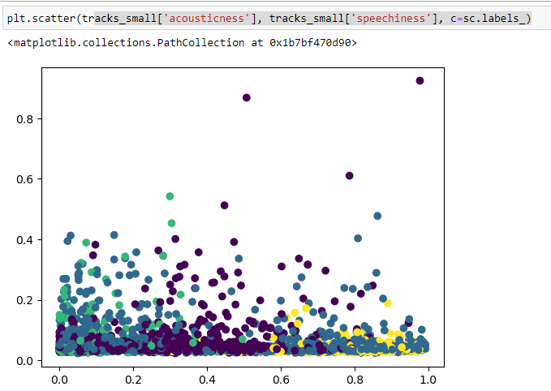
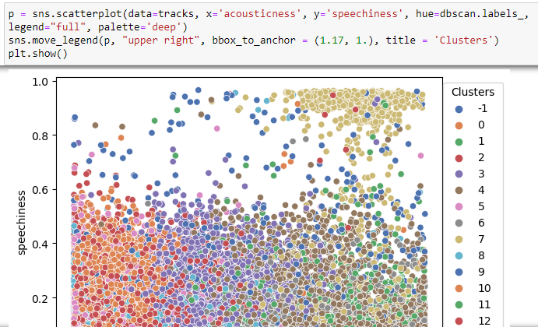
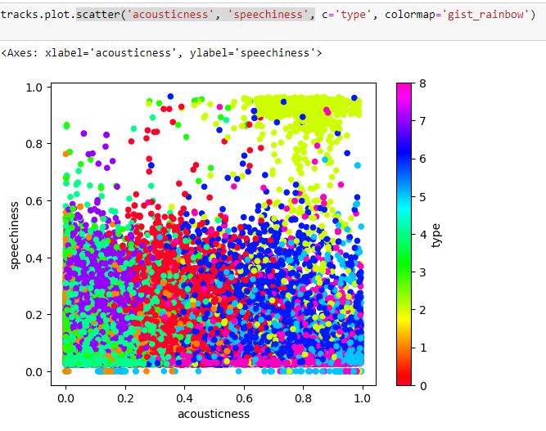
Enhancements (Cont.)
Spectral clustering DBSCAN K-Means

Slide 5
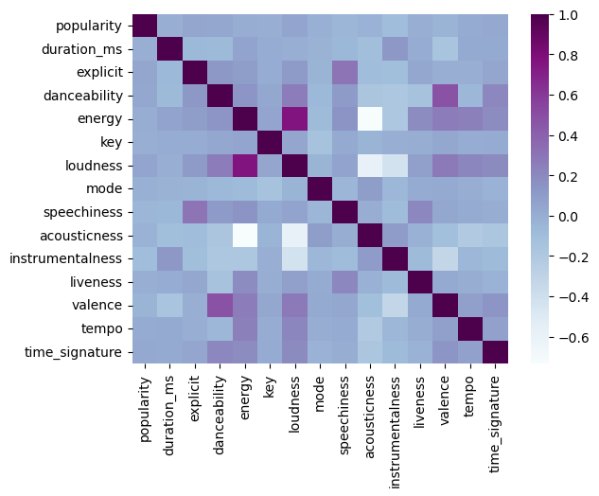
Findings from data - Heat map
There is a strong negative correlation between acousticness and loudness
Acoustic songs are usually very mellow and are not very loud
There is a strong positive correlation between energy and loudness
More energetic music like rock and roll are usually loud

Slide 6
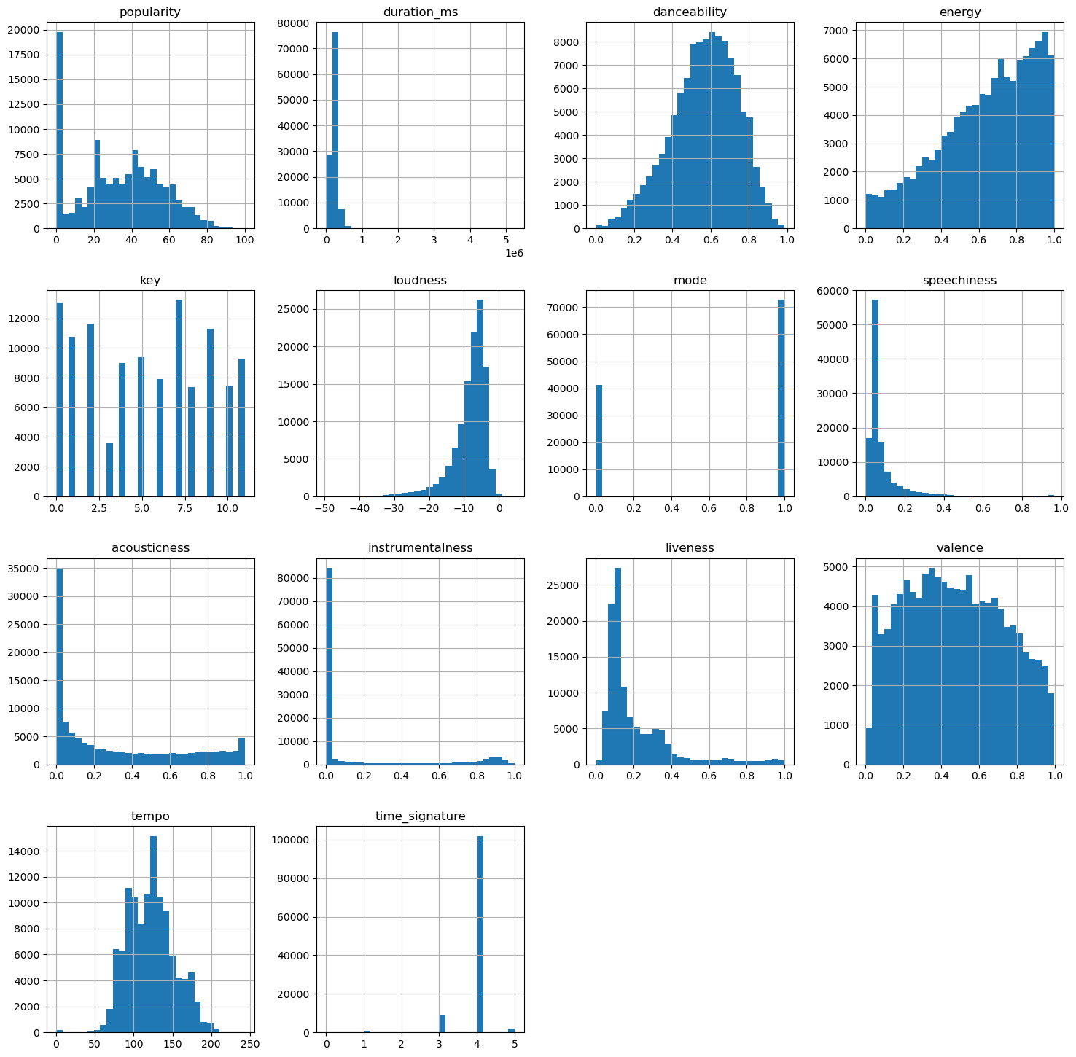
Findings from data - histograms
Pretty much every song has a 4 time signature and none of have a 0 or 2 time signature
Songs with high valance sound more positive while songs with low valance are more sad
The tempo of all the songs are much more centralized.

Slide 8
User Interaction and Feedback
Incorporating user interaction allows the model to make more accurate predictions for the user because of their prolonged exposure to the user’s taste in music.
We introduced a simple but effective feature that allows the user to heart a song that they enjoy. This explicit feedback provides a music or artist taste that pleases the user, which our model can use to identify future patterns.

Slide 9
Future enhancements
Implement measures to prevent over-recommending the same songs or artists to the user. This ensures a fresh, engaging listening experience.
Utilize the time of day or other contextual factors to provide mood-based song suggestions

